Slide 1
Project Cost
Budget planning vs return

Slide 2

Project reengineering, helpdesk,socialization
Project Management
Technology
Software
Analysis, EPR, system test, user test, maintenance
Business/Organization

Slide 3

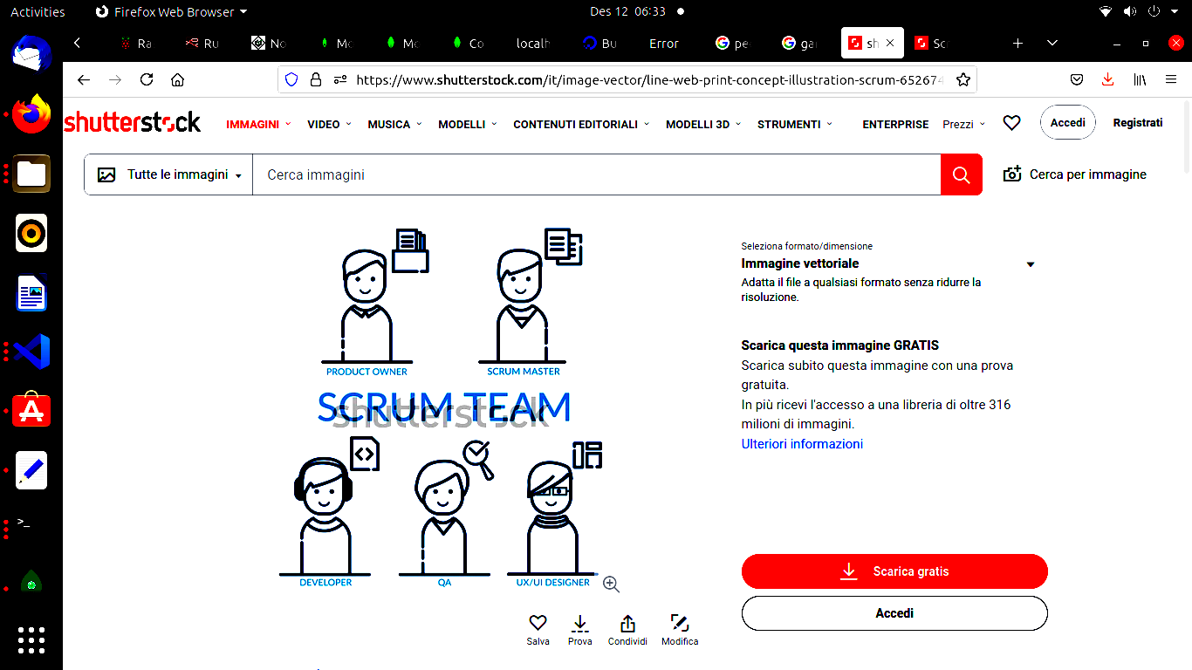
Project Management
Component
Man
power
Fee/
hours
Sprint (8) * Days (25)
* 9 hours
1
Product
Owner
1
30 €
8*25*9*30 € = 54.000 €
2
Scrum
Master
1
30 €
8*25*9*30 € = 54.000 €
3
Developer
3
20 €
3*8*25*9*20 €=108.000 €
4
QA
1
15 €
4 sprints only
4*25*9*15 €= 13.500 €
5
UI/UX designer
2
20 €
4 sprints only
2*4*25*9*20 €=36.000 €
Budget planning
TOTAL 264.500 €

Slide 4
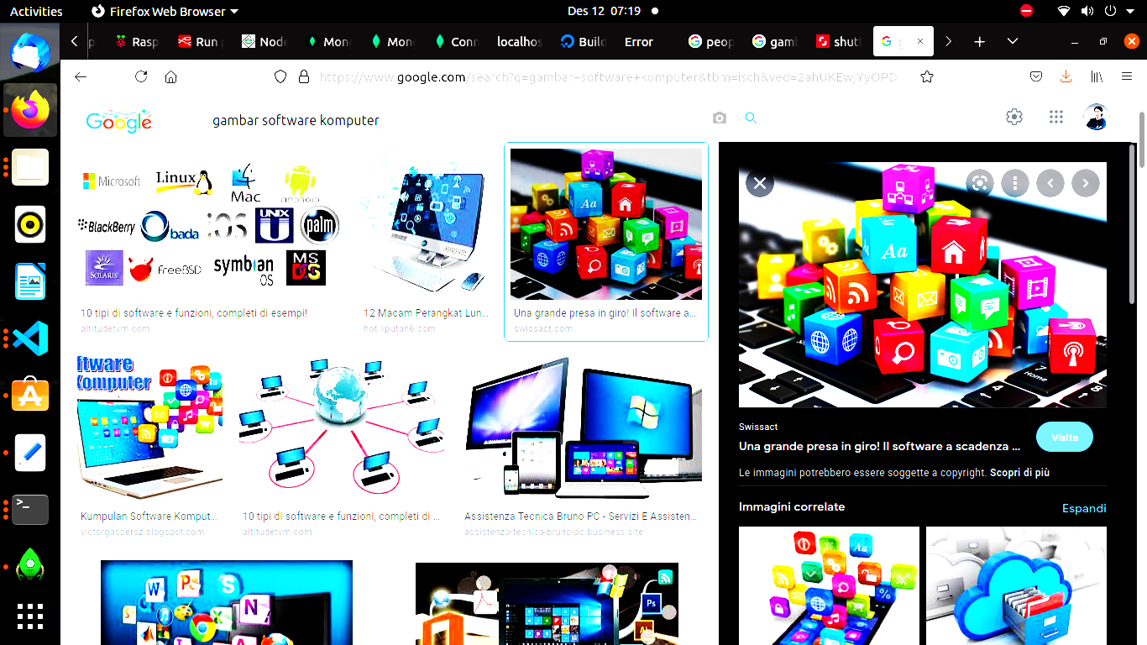
ANALYSIS
-Cost for survey and interview
EPR
-Data integration
-Data migration
1
2
SOFTWARE
USER TEST
- PC + ETHERNET
- Internet
- Url address for testing
SYSTEM TEST
-Performance test (stress test, regulatory & compliance, functionality, scalability, regrssion)
3
4
MAINTENANCE
-Software maintenance/after delivery
-Hardware maintenance
5

Slide 5
ANALYSIS
-Cost for survey and interview
3 € X 100 = 300 €
1
SOFTWARE

Slide 6
EPR
-Data integration
-Data migration
Using pentaho : kettle for data integration and migration : 25.000 USD = 22.091,12 € (annual)
2
SOFTWARE

Slide 7
SOFTWARE
USER TEST
- PC + ETHERNET
100 PC * 50 € = 5.000 €
- Internet
3 times testing * 25 € = 75 €
- HTTPS certificate
Digicert Secure site business (annual) = 347 USD = 306.62 €
3

Slide 8
SOFTWARE
SYSTEM TEST
-Performance test (stress test, regulatory & compliance, functionality, scalability, regrssion)
4
AWS service | Dimensions | Cost per month
AWS Fargate | 10 on-demand tasks (using two vCPUs and 4 GB memory) running for 30 hours | $29.62
Amazon DynamoDB | 1,000 on-demand write capacity units 1,000 on-demand read capacity units | $0.0015
AWS Lambda | 1,000 requests 10 minutes total duration | $0.00146
AWS Step Functions | 1,000 state transitions | $0.025
Total: |  | $29.65 / month = 314.4 € / annum

Slide 9
SOFTWARE
MAINTENANCE
-Software maintenance/after delivery
-Hardware maintenance
7000 doctors (PC, bug issues) * 15 € /hours * 5 hours = 525.000 € (annual)
5

Slide 10
Business/Organization
1. Project reengineering : hire a new operation staff and internet package for doctors. Assume 15 € * 7000 doctors per month, new operation staff (helpdesk) 5 operators * 1500 € per month 2. Helpdesk ( implementation chatbot )->no cost, on call heldesk : need a dedicated line telephone = 5 line dedicated * 15 € per month 3. Socialization ( video presentation -> created by team UI/UX ( cost included)), advertisement on e-billboard or TV or internet= 5000 € per month * 4 months
Total per annum :
Internet package : 1.260.000 €
Operation staff : 90.000 €
Line : 900 €
Advertisement : 2.000 €
1.352.900 €

Slide 11

Technology (I)
cloud implementation :
34 KB per request / 512 KB request increment = RoundUp (0.06640625) = 1 billable request(s)
50 requests per month x 1,000,000 unit multiplier x 1 billable request(s) = 50,000,000 total billable request(s)
Tiered price for: 50000000 requests
50000000 requests x 0.0000011700 USD = 58.50 USD
Total tier cost = 58.5000 USD (HTTP API requests)
API gateway (monthly): 58.50 USD
10 requests x 1,000,000 unit multiplier = 10,000,000 total REST API requests
Tiered price for: 10000000 requests
10000000 requests x 0.0000036800 USD = 36.80 USD
Total tier cost = 36.8000 USD (REST API requests)
Tiered price total for REST API requests: 36.80 USD
0.26 USD per hour x 730 hours in a month = 189.80 USD for cache memory
Dedicated cache memory total price: 189.80 USD
36.80 USD + 189.80 USD = 226.60 USD
REST API cost (monthly): 226.60 USD
TECHNOLOGY

Slide 12
Technology (II)
cloud implementation :
Total number of queries: 1000 per day * (730 hours in a month / 24 hours in a day) = 30416.67 queries per month
Data amount scanned per query: 1 GB x 0.0009765625 TB in a GB = 0.0009765625 TB
Rounding (30416.67) = 30417 Rounded total number of queries
30,417 queries per month x 0.0009765625 TB x 5.00 USD = 148.52 USD
Amazon Athena pricing (monthly): 148.52 USD
Tiered price for: 500 GB
500 GB x 0.0230000000 USD = 11.50 USD
Total tier cost = 11.5000 USD (S3 Standard storage cost)
1,000 PUT requests for S3 Storage x 0.000005 USD per request = 0.005 USD (S3 Standard PUT requests cost)
1,000 GET requests in a month x 0.0000004 USD per request = 0.0004 USD (S3 Standard GET requests cost)
100 GB x 0.0007 USD = 0.07 USD (S3 select returned cost)
100 GB x 0.002 USD = 0.20 USD (S3 select scanned cost)
11.50 USD + 0.0004 USD + 0.005 USD + 0.07 USD + 0.20 USD = 11.78 USD (Total S3 Standard Storage, data requests, S3 select cost)
S3 Standard cost (monthly): 11.78 USD
TECHNOLOGY

Slide 13
Technology (III)
cloud implementation :
S3 Standard storage overhead cost: 0.0056152 USD
500 GB per month x 0.0036 USD = 1.80 USD (Glacier storage cost)
Glacier storage overhead cost: 0.0035156 USD
Glacier storage cost: 1.80 USD
0.0035156 USD + 0.0056152 USD + 1.80 USD = 1.809131 USD (total Glacier storage cost)
100 requests x 0.000033 USD = 0.0033 USD (PUT, COPY, POST, LIST requests to S3 Glacier cost)
100 requests x 0.000033 USD = 0.0033 USD (Lifecycle transitions cost)
100 requests x 0.000055 USD = 0.0055 USD (Cost for Restore requests (Standard))
100 requests x 0.011 USD = 1.10 USD (Cost for Restore requests (Expedited))
100 GB per month x 0.01 USD = 1.00 USD (Cost for Data retrievals (Standard))
100 GB per month x 0.03 USD = 3.00 USD (Cost for Data retrievals (Expedited))
1.809131 USD + 0.0033 USD + 0.0033 USD + 0.0055 USD + 1.10 USD + 1.00 USD + 3.00 USD = 6.92 USD (Total Data Retrieval cost )
S3 Glacier cost (monthly): 6.92 USD
TECHNOLOGY

Slide 14
Technology(IV)
cloud implementation :
AWS Cloudfront 10.51 USD
Total cost per month : 314.31 USD = 277.74 €
Total cost annually : 3771.72 USD = 3.332.86 €
TECHNOLOGY

Slide 15

Cost
Project Management
Software
Business/
Organization
Technology
Analysis
EPR
Project Reengineering
Cloud
People
System test
Helpdesk
User test
Maintenance
Socialization
*based on calculation

Slide 16

Benefit
MANAGEMENT VALUE
SOCIAL VALUE
Tangible
Intangible
Tangible
Intangible
Image
Cost saving
Risk reduction
Social saving
QOS
Compliance
Sales increase
Higher value
KPI
QOS
Governance

Slide 17
People : 264.500,00 €
Software :
Analysis 300,00 €
EPR 22.091,12 €
User test 306,62 €
System test 314,40 €
Maintenance 525.000,00 €
Business : 1.352.900,00 €
Tech : 3.332,86 €
Total expenses : 2.168.745,00 €
Prediction of total cost annually (1st year)

Slide 18
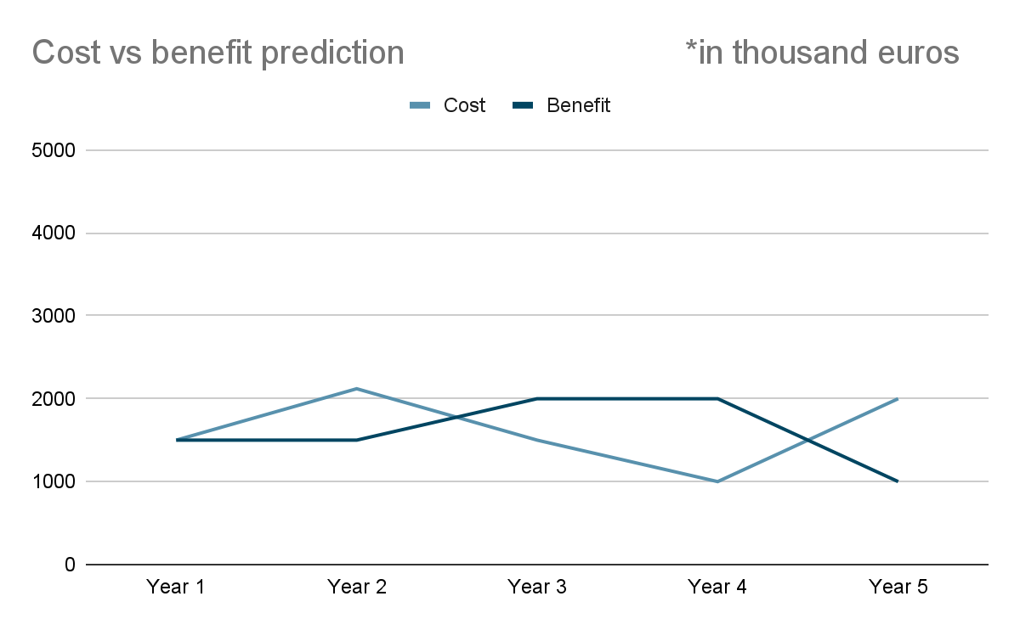
Cost prediction for implementing the system from the first year until the end of system life cycle
Assumption :
1st year : 75% of costs applicable
2nd year : 100% of costs applicable
3rd year : 75% of costs applicable
4th year : 50% of costs applicable
5th year : almost 100% of costs (including project reenginering at the end of the system life cycle)
 | Cost | Benefit
Year 1 | 1500 | 1500
Year 2 | 2120 | 1500
Year 3 | 1500 | 2000
Year 4 | 1000 | 2000
Year 5 | 2000 | 1000

Slide 19
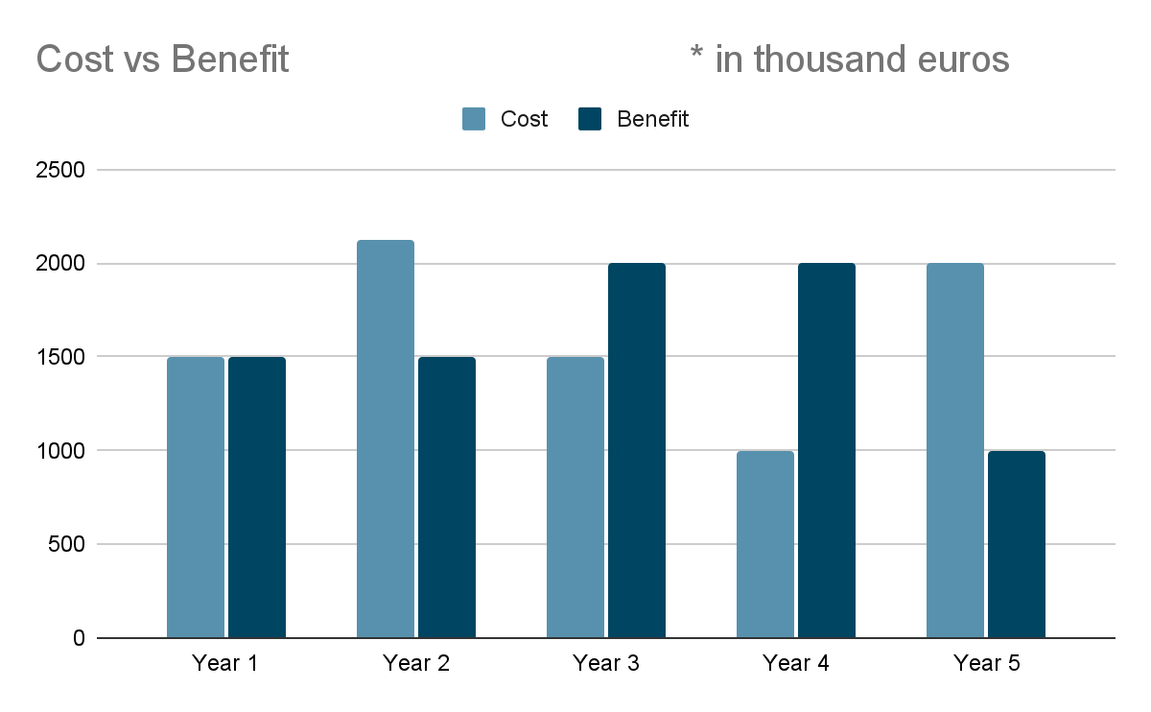
Cost prediction for implementing the system from the first year until the end of system life cycle
 | Cost | Benefit
Year 1 | 1500 | 1500
Year 2 | 2120 | 1500
Year 3 | 1500 | 2000
Year 4 | 1000 | 2000
Year 5 | 2000 | 1000

